Slide 1
Review
Matrices and Vectors
Objective
To provide background material in support of topics in Digital Image Processing that are based on matrices and/or vectors.

Slide 2
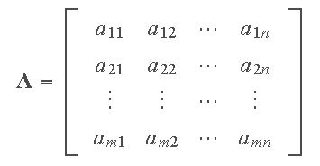
Some Definitions
An m×n (read "m by n") matrix, denoted by A, is a rectangular array of entries or elements (numbers, or symbols representing numbers) enclosed typically by square brackets, where m is the number of rows and n the number of columns.

Slide 3
Definitions (Con’t)
A is square if m= n.
A is diagonal if all off-diagonal elements are 0, and not all diagonal elements are 0.
A is the identity matrix ( I ) if it is diagonal and all diagonal elements are 1.
A is the zero or null matrix ( 0 ) if all its elements are 0.
The trace of A equals the sum of the elements along its main diagonal.
Two matrices A and B are equal iff the have the same number of rows and columns, and a_{ij} = b_{ij} .

Slide 4
Definitions (Con’t)
The transpose A^{T} of an m×n matrix A is an n×m matrix obtained by interchanging the rows and columns of A.
A square matrix for which A^{T}=A is said to be symmetric.
Any matrix X for which XA=I and AX=I is called the inverse of A.
Let c be a real or complex number (called a scalar). The scalar multiple of c and matrix A, denoted cA, is obtained by multiplying every elements of A by c. If c = −1, the scalar multiple is called the negative of A.

Slide 5
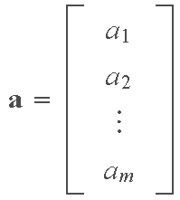


Definitions (Con’t)
A column vector is an m × 1 matrix:
A row vector is a 1 × n matrix:
A column vector can be expressed as a row vector by using
the transpose:

Slide 6

Some Basic Matrix Operations
The sum of two matrices A and B (of equal dimension), denoted A + B, is the matrix with elements a_{ij} + b_{ij}.
The difference of two matrices, A− B, has elements a_{ij} − b_{ij}.
The product, AB, of m×n matrix A and p×q matrix B, is an m×q matrix C whose (i,j)-th element is formed by multiplying the entries across the ith row of A times the entries down the jth column of B; that is,

Slide 7
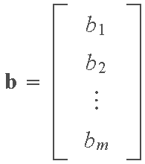
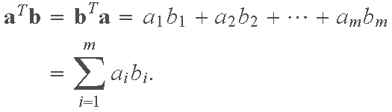
Some Basic Matrix Operations (Con’t)
The inner product (also called dot product) of two vectors
is defined as
Note that the inner product is a scalar.

Slide 8
Vectors and Vector Spaces
A vector space is defined as a nonempty set V of entities called vectors and associated scalars that satisfy the conditions outlined in A through C below. A vector space is real if the scalars are real numbers; it is complex if the scalars are complex numbers.
Condition A: There is in V an operation called vector addition, denoted x + y, that satisfies:
1. x + y = y + x for all vectors x and y in the space.
2. x + (y + z) = (x + y) + z for all x, y, and z.
3. There exists in V a unique vector, called the zero vector, and denoted 0, such that x + 0 = x and 0 + x = x for all vectors x.
4. For each vector x in V, there is a unique vector in V, called the negation of x, and denoted −x, such that x + (− x) = 0 and (− x) + x = 0.

Slide 9
Vectors and Vector Spaces (Con’t)
Condition B: There is in V an operation called multiplication by a scalar that associates with each scalar c and each vector x in V a unique vector called the product of c and x, denoted by cx and xc, and which satisfies:
1. c(dx) = (cd)x for all scalars c and d, and all vectors x.
2. (c + d)x = cx + dx for all scalars c and d, and all vectors x.
3. c(x + y) = cx + cy for all scalars c and all vectors x and y.
Condition C: 1x = x for all vectors x.

Slide 10
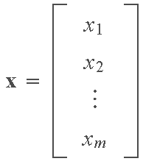
Vectors and Vector Spaces (Con’t)
We are interested particularly in real vector spaces of real m×1 column matrices. We denote such spaces by ℜ^{m} , with vector addition and multiplication by scalars being as defined earlier for matrices. Vectors (column matrices) in ℜ^{m} are written as

Slide 11
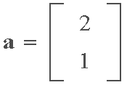
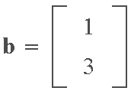
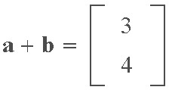
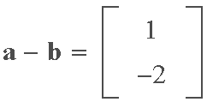
Vectors and Vector Spaces (Con’t)
Example
The vector space with which we are most familiar is the two-dimensional real vector space ℜ² , in which we make frequent use of graphical representations for operations such as vector addition, subtraction, and multiplication by a scalar. For instance, consider the two vectors
Using the rules of matrix addition and subtraction we have

Slide 12
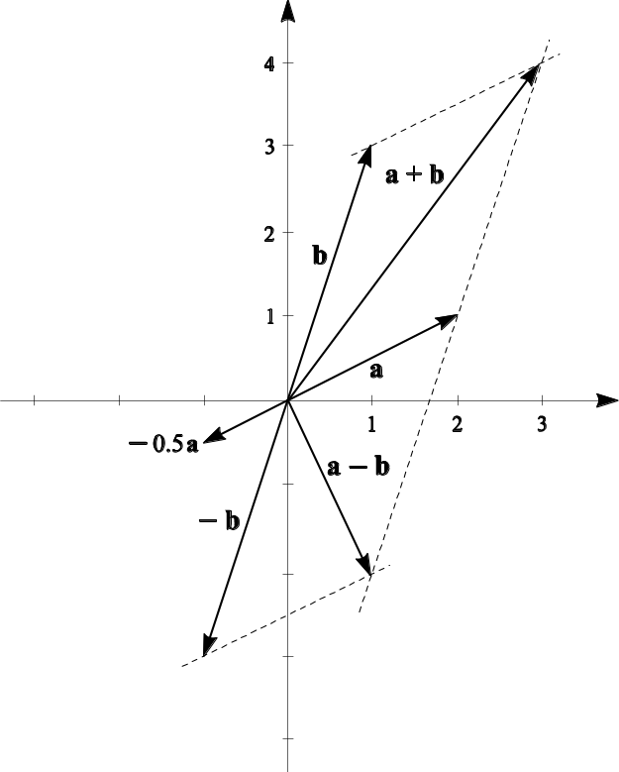
Vectors and Vector Spaces (Con’t)
Example (Con’t)
The following figure shows the familiar graphical representation of the preceding vector operations, as well as multiplication of vector a by scalar c = −0.5.

Slide 13
Vectors and Vector Spaces (Con’t)
Consider two real vector spaces V₀ and V such that:
Each element of V₀ is also an element of V (i.e., V₀ is a subset of V).
Operations on elements of V₀ are the same as on elements of V. Under these conditions, V₀ is said to be a subspace of V.
A linear combination of v₁,v₂,…,v_{n} is an expression of the form
where the α’s are scalars.

Slide 14
Vectors and Vector Spaces (Con’t)
A vector v is said to be linearly dependent on a set, S, of vectors v₁,v₂,…,v_{n} if and only if v can be written as a linear combination of these vectors. Otherwise, v is linearly independent of the set of vectors v₁,v₂,…,v_{n} .

Slide 15
Vectors and Vector Spaces (Con’t)
A set S of vectors v₁,v₂,…,v_{n} in V is said to span some subspace V₀ of V if and only if S is a subset of V₀ and every vector v₀ in V₀ is linearly dependent on the vectors in S. The set S is said to be a spanning set for V₀. A basis for a vector space V is a linearly independent spanning set for V. The number of vectors in the basis for a vector space is called the dimension of the vector space. If, for example, the number of vectors in the basis is n, we say that the vector space is n-dimensional.

Slide 16
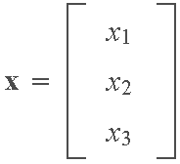
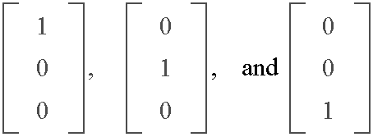
Vectors and Vector Spaces (Con’t)
An important aspect of the concepts just discussed lies in the representation of any vector in ℜ^{m} as a linear combination of the basis vectors. For example, any vector
in ℜ³ can be represented as a linear combination of the basis
vectors

Slide 17
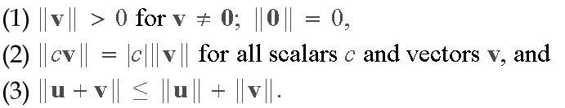
Vector Norms
A vector norm on a vector space V is a function that assigns to each vector v in V a nonnegative real number, called the norm of v, denoted by ||v||. By definition, the norm satisfies the following conditions:

Slide 18


Vector Norms (Con’t)
There are numerous norms that are used in practice. In our work, the norm most often used is the so-called 2-norm, which, for a vector x in real ℜ^{m}, space is defined as
which is recognized as the Euclidean distance from the origin to point x; this gives the expression the familiar name Euclidean norm. The expression also is recognized as the length of a vector x, with origin at point 0. From earlier discussions, the norm also can be written as

Slide 19



Vector Norms (Con’t)
The Cauchy-Schwartz inequality states that
Another well-known result used in the book is the expression
where θ is the angle between vectors x and y. From these expressions it follows that the inner product of two vectors can be written as
Thus, the inner product can be expressed as a function of the norms of the vectors and the angle between the vectors.

Slide 20
Vector Norms (Con’t)
From the preceding results, two vectors in ℜ^{m} are orthogonal if and only if their inner product is zero. Two vectors are orthonormal if, in addition to being orthogonal, the length of each vector is 1.
From the concepts just discussed, we see that an arbitrary vector a is turned into a vector a_{n} of unit length by performing the operation a_{n} = a/||a||. Clearly, then, ||a_{n}|| = 1.
A set of vectors is said to be an orthogonal set if every two vectors in the set are orthogonal. A set of vectors is orthonormal if every two vectors in the set are orthonormal.

Slide 21
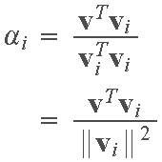
Some Important Aspects of Orthogonality
Let B = {v₁,v₂,…,v_{n} } be an orthogonal or orthonormal basis in the sense defined in the previous section. Then, an important result in vector analysis is that any vector v can be represented with respect to the orthogonal basis B as
where the coefficients are given by

Slide 22
Orthogonality (Con’t)
The key importance of this result is that, if we represent a vector as a linear combination of orthogonal or orthonormal basis vectors, we can determine the coefficients directly from simple inner product computations. It is possible to convert a linearly independent spanning set of vectors into an orthogonal spanning set by using the well-known Gram-Schmidt process. There are numerous programs available that implement the Gram-Schmidt and similar processes, so we will not dwell on the details here.

Slide 23
Eigenvalues & Eigenvectors
Definition: The eigenvalues of a real matrix M are the real numbers λ for which there is a nonzero vector e such that
Me = λ e.
The eigenvectors of M are the nonzero vectors e for which there is a real number λ such that Me = λ e.
If Me = λ e for e ≠ 0, then e is an eigenvector of M associated with eigenvalue λ, and vice versa. The eigenvectors and corresponding eigenvalues of M constitute the eigensystem of M.
Numerous theoretical and truly practical results in the application of matrices and vectors stem from this beautifully simple definition.

Slide 24
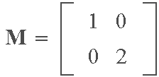
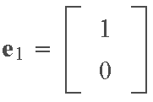
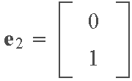
Eigenvalues & Eigenvectors (Con’t)
Example: Consider the matrix
and
In other words, e₁ is an eigenvector of M with associated
eigenvalue λ₁, and similarly for e₂ and λ₂.

Slide 25
Eigenvalues & Eigenvectors (Con’t)
The following properties, which we give without proof, are essential background in the use of vectors and matrices in digital image processing. In each case, we assume a real matrix of order m×m although, as stated earlier, these results are equally applicable to complex numbers.
1. If {λ₁, λ₂,…, λ_{q}, q ≤ m, is set of distinct eigenvalues of M, and e_{i} is an eigenvector of M with corresponding eigenvalue λ_{i}, i = 1,2,…,q, then {e₁,e₂,…,e_{q}} is a linearly independent set of vectors. An important implication of this property: If an m×m matrix M has m distinct eigenvalues, its eigenvectors will constitute an orthogonal (orthonormal) set, which means that any m-dimensional vector can be expressed as a linear combination of the eigenvectors of M.

Slide 26
Eigenvalues & Eigenvectors (Con’t)
2. The numbers along the main diagonal of a diagonal matrix are equal to its eigenvalues. It is not difficult to show using the definition Me = λ e that the eigenvectors can be written by inspection when M is diagonal.
3. A real, symmetric m×m matrix M has a set of m linearly independent eigenvectors that may be chosen to form an orthonormal set. This property is of particular importance when dealing with covariance matrices (e.g., see Section 11.4 and our review of probability) which are real and symmetric.

Slide 27
Eigenvalues & Eigenvectors (Con’t)
4. A corollary of Property 3 is that the eigenvalues of an m×m real symmetric matrix are real, and the associated eigenvectors may be chosen to form an orthonormal set of m vectors.
5. Suppose that M is a real, symmetric m×m matrix, and that we form a matrix A whose rows are the m orthonormal eigenvectors of M. Then, the product AA^{T}=I because the rows of A are orthonormal vectors. Thus, we see that A⁻¹= A^{T} when matrix A is formed in the manner just described.
6. Consider matrices M and A in 5. The product D = AMA⁻¹ = AMA^{T} is a diagonal matrix whose elements along the main diagonal are the eigenvalues of M. The eigenvectors of D are the same as the eigenvectors of M.

Slide 28

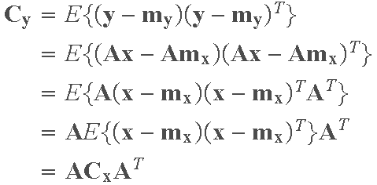
Eigenvalues & Eigenvectors (Con’t)
Example
Suppose that we have a random population of vectors, denoted by {x}, with covariance matrix (see the review of probability):
Suppose that we perform a transformation of the form y = Ax on each vector x, where the rows of A are the orthonormal eigenvectors of C_{x}. The covariance matrix of the population {y} is

Slide 29
Eigenvalues & Eigenvectors (Con’t)
From Property 6, we know that C_{y}=AC_{x}A^{T} is a diagonal matrix with the eigenvalues of C_{x} along its main diagonal. The elements along the main diagonal of a covariance matrix are the variances of the components of the vectors in the population. The off diagonal elements are the covariances of the components of these vectors.
The fact that C_{y} is diagonal means that the elements of the vectors in the population {y} are uncorrelated (their covariances are 0). Thus, we see that application of the linear transformation y = Ax involving the eigenvectors of C_{x} decorrelates the data, and the elements of C_{y} along its main diagonal give the variances of the components of the y's along the eigenvectors. Basically, what has

Slide 30
Eigenvalues & Eigenvectors (Con’t)
been accomplished here is a coordinate transformation that aligns the data along the eigenvectors of the covariance matrix of the population.
The preceding concepts are illustrated in the following figure. Part (a) shows a data population {x} in two dimensions, along with the eigenvectors of C_{x} (the black dot is the mean). The result of performing the transformation y=A(x − m_{x}) on the x's is shown in Part (b) of the figure.
The fact that we subtracted the mean from the x's caused the y's to have zero mean, so the population is centered on the coordinate system of the transformed data. It is important to note that all we have done here is make the eigenvectors the

Slide 31
Eigenvalues & Eigenvectors (Con’t)
new coordinate system (y₁,y₂). Because the covariance matrix of the y's is diagonal, this in fact also decorrelated the data. The fact that the main data spread is along e₁ is due to the fact that the rows of the transformation matrix A were chosen according the order of the eigenvalues, with the first row being the eigenvector corresponding to the largest eigenvalue.

Slide 32
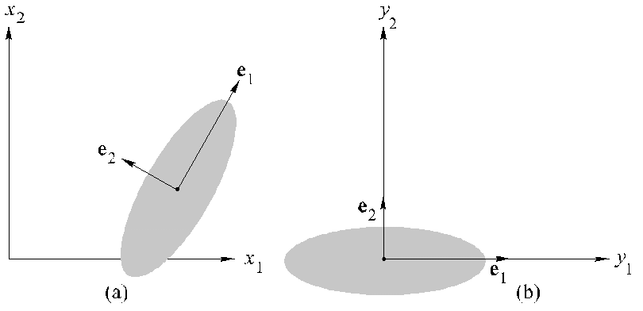
Eigenvalues & Eigenvectors (Con’t)

